Slide 1

DEPARTMENT OF COMPUTER SCIENCE AND ENGINEERING DIT INIVERSITY, DEHRADUN MAKKA WALA, DIVERSION ROAD
FACE MASK DETECTION
Submitted by: Group no: IBM19-G20 Kushagra Sinha (190111031) Alok Ranjan Tiwari(190111032) Rishi Raj Singh Chauhan (190111033)
Sourav Kumar Mahto(190111034)
Under the guidance of : DR.VINAY GAUTAM

Slide 2


Presentation Outline
Problem Definition
Objectives
Related Works
Requirement Specification
UML Diagrams
Algorithms/Methodologies Used
Results and Demo
Conclusion/Future Work
References

Slide 3




Problem Definition
Whether people are abiding by the rules and regulations to wear protective masks at public places.
No means to ensure that the safety guidelines are followed
Absence of large datasets of real ‘with_mask’ images
No efficient face mask detection application implemented till now!

Slide 4



Objectives
To train a custom deep learning model to detect whether a person is wearing a mask or not.
To develop a custom dataset of real with_mask images with Search APIs and existing datasets.
To implement the trained model to detect masks in images/videos.
The model is expected to give an accuracy of 90% and above

Slide 5
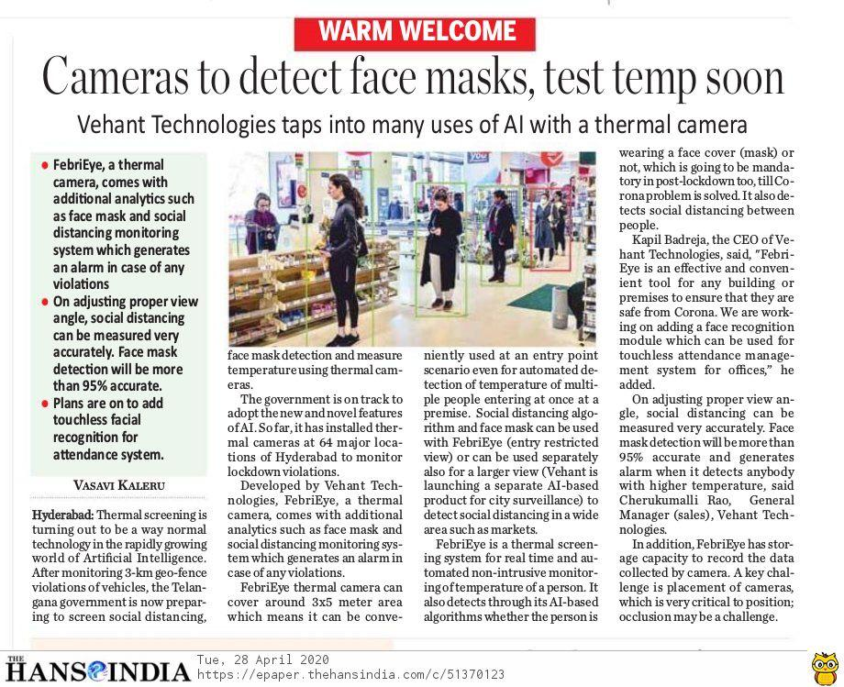
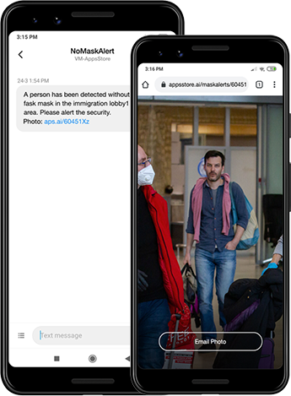
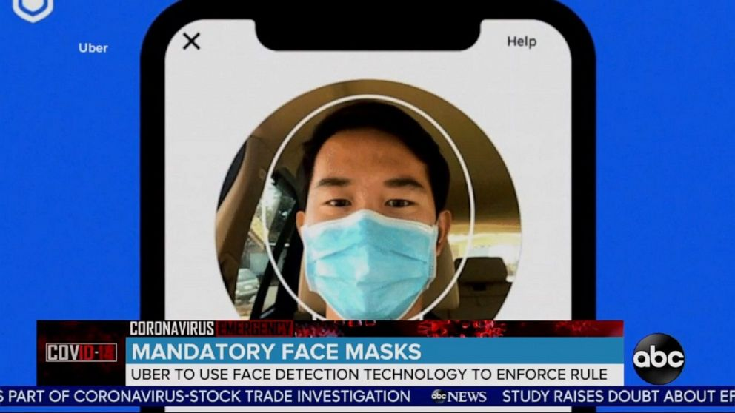
Related Works
PROPOSED IDEAS
(still not implemented)
Karnataka (Vehant Technologies)
Leewayhertz software solutions
Uber Technologies

Slide 6

Requirement Specification
Functional Requirements
R1: The system must have an unbiased, over 1500+ images with/without mask dataset which unique images in train and test phases.
R2: The system must be able to detect faces in images or video stream and extract each face’s Region of Interest (ROI).
R3: There must not be any object between the system and the face of the user for a successful detection and hence the face mask detection.
R4: Correctly able to detect masks in ‘png’, ‘jpg’, ‘jpeg’, and ‘gif’ format images and on human faces on every frame in a live video.
R5: The results must be showing the probability along with the label of ‘Mask’ or ‘No Mask’.

Slide 7

Non-Functional Requirements
R1: The face should be localized by detecting the facial landmarks and the background must be ignored.
R2: The user must not move his/her face out of camera’s sight in order to get correct results and background must not be too bright or too dark.
R3: The system must be portable and can be applied to embedded devices with limited computational capacity (ex., Raspberry Pi, Google Coral, NVIDIA Jetson Nano, etc.).
R4: The output response operation must be fast and under 5 seconds per person.
R5: The system should be easy for usability and self-descriptive for maintenance purposes.

Slide 8
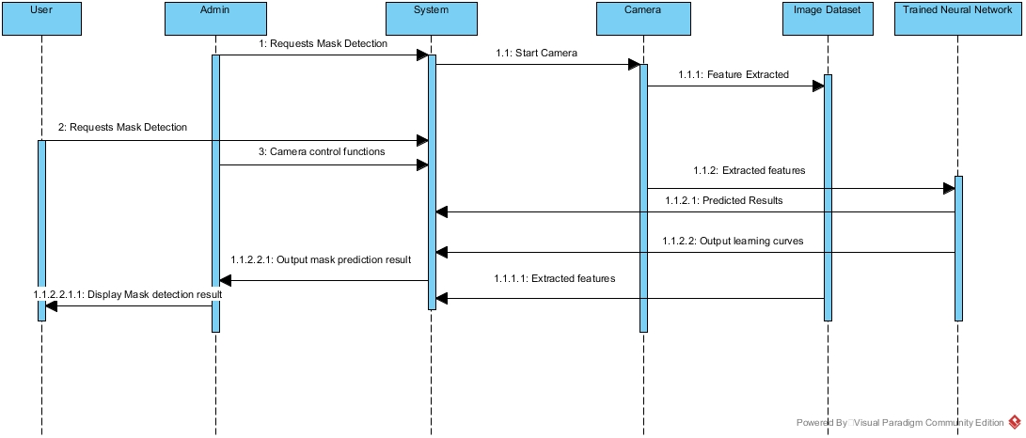
UML Diagrams
Sequence Diagram

Slide 9
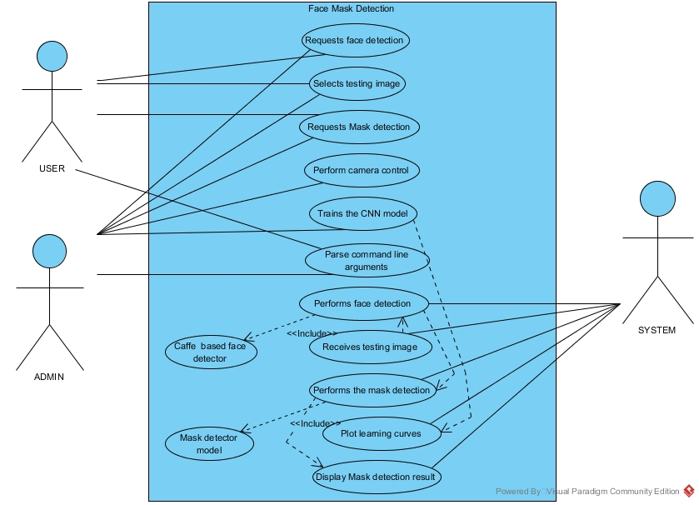
Use Case Diagram
Use Case Diagram for Face Mask Detection System

Slide 10
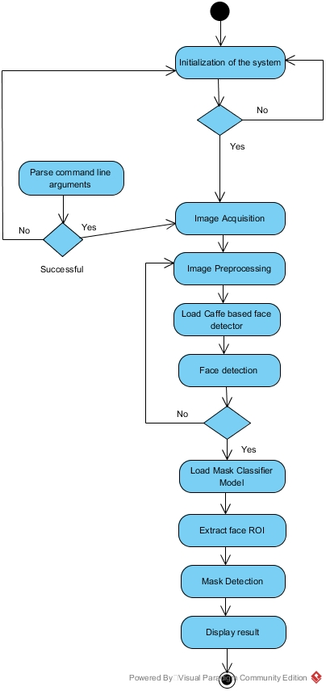
Activity Diagram
Activity Diagram for Face Mask Detection in static input Images

Slide 11
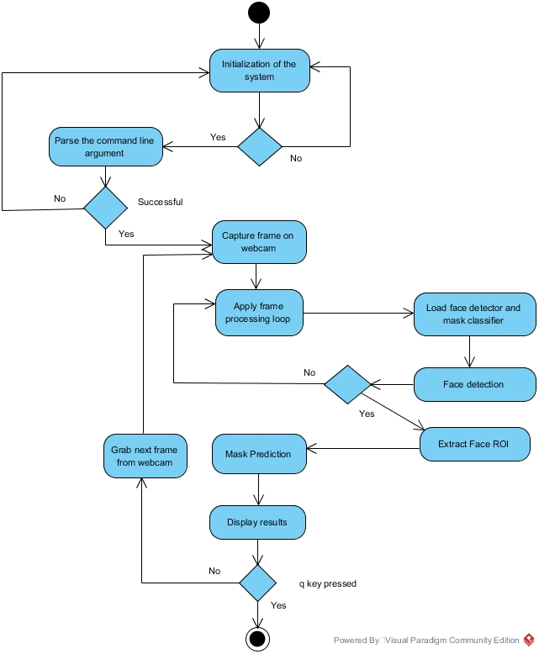
Activity Diagram
Activity Diagram for Face Mask Detection in Real-time Video Streams

Slide 12
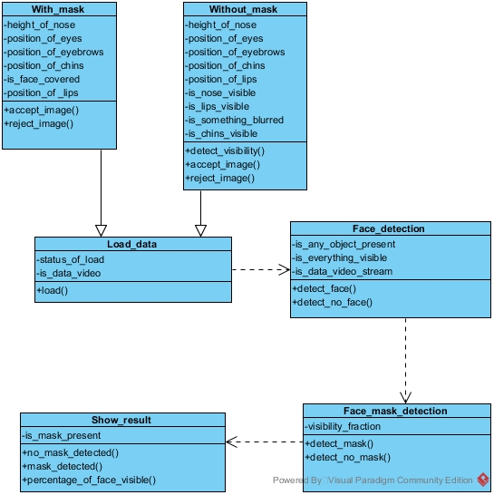
Class Diagram
Class Diagram for Face Mask Detection System

Slide 13
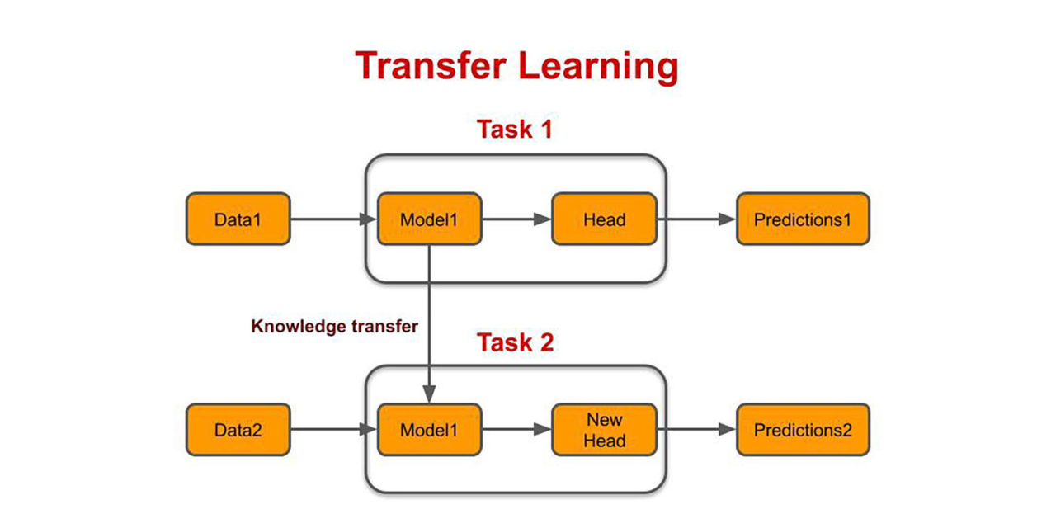
Algorithms Used
Transfer Learning: The process of using a pre-trained model that has been trained on a dataset for training and predicting on a new given dataset.
Transfer Learning with a pre-trained ConvNet:
Feature Extraction: a new classifier, which will be trained from scratch, on top of the pre-trained model
Fine-Tuning: Using MobileNetV2 architecture, which is pre-trained on the ImageNet dataset, a large dataset consisting of 1.4M images and 1000 classes.

Slide 14


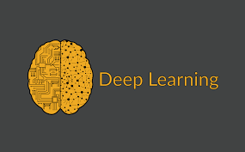
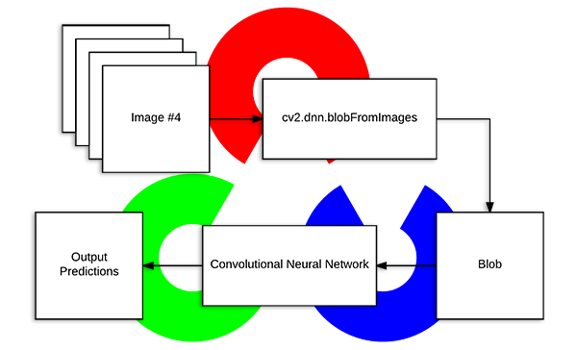
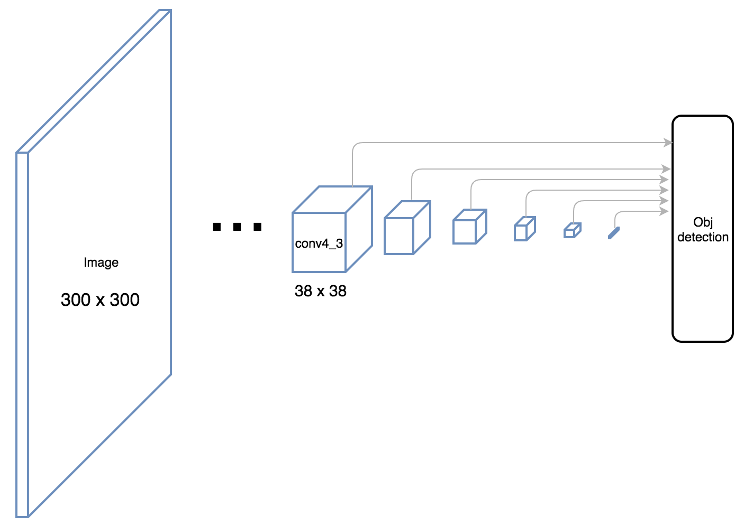
Methodologies
OpenCV’s “deep neural networks” (dnn) module
OpenCV’s face detector based on the Single Shot Multibox Detector (SSD) framework combined with MobileNetV2 architecture
OpenCV’s blobFromImage and blobFromImages to facilitate image pre-processing
Keras ImageDataGenerator

Slide 15
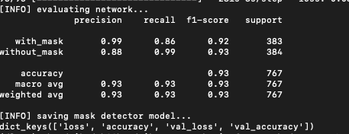

Results
Precision/Recall scores for our mask detection model after training
Accuracy = 93%

Slide 16
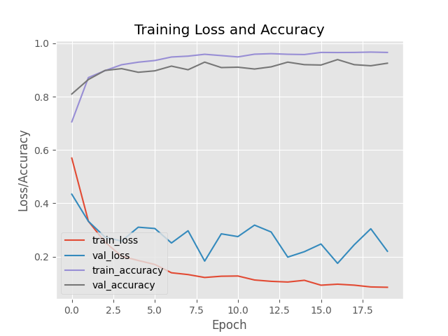


Training Curve

Slide 17
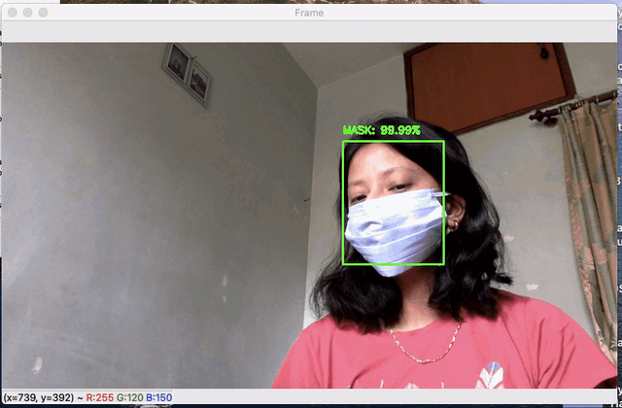
Demo Video
IMPLEMENTATION

Slide 18


Conclusion
To create our face mask detector, we trained a two-class model with images of people wearing masks and not wearing masks.
We then fine-tuned our model using MobileNetV2 on our mask/no mask dataset and obtained an image classifier that was 93% accurate.
Future Work
We should train a two-class object detector that consists of a ‘with_mask’ class and ‘without_mask’ class.
This approach reduces our computer vision pipeline to a single step — rather than applying face detection and then our face mask detector model
Developing an Android and/or Web Application for the same in future.

Slide 19

References
[1] https://keras.io/api/applications/mobilenet/ - mobilenetv2-function
[2] https://arxiv.org/abs/1704.04861
[3] https://www.pyimagesearch.com/2019/06/03/fine-tuning-with-keras-and-deep-learning/
[4] https://github.com/X-zhangyang/Real-World-Masked-Face-Dataset
[5] https://github.com/AIZOOTech/FaceMaskDetection
[6] https://www.pyimagesearch.com/2018/04/09/how-to-quickly-build-a-deep-learning-image-dataset/
[7] https://gogul.dev/software/flower-recognition-deep-learning
[8] https://www.tensorflow.org/tutorials/images/transfer_learning
[9] https://towardsdatascience.com/detecting-faces-with-python-and-opencv-face-detection-neural-network-f72890ae531c
[10] https://www.indulgexpress.com/msociety/2020/may/04/hyderabad-company-launches-ai-based-surveillance-tech-to-detect-face-mask-and-social-distancing-viol-24656.html
[11] https://www.engadget.com/uber-face-mask-detection-technology-184137514.html
[12] https://www.leewayhertz.com/face-mask-detection-system/
[13] https://www.thehansindia.com/telangana/hyderabad-cameras-to-detect-face-masks-test-temp-soon-619505
[14] https://www.kaggle.com/chandrikadeb/face-mask-dataset
[15] https://www.pyimagesearch.com/2019/07/08/keras-imagedatagenerator-and-data-augmentation/

